Slide 1



Welcome to the world of synthetic data for privacy!
Scaling While Privacy Preserving: a Comprehensive Synthetic Tabular Data Generation and Evaluation in Learning Analytics
22nd March, 2024

Slide 2




Authors
Qinyi Liu
Centre for the Science of Learning & Technology (SLATE), University of Bergen, Norway
qinyi.liu@uib.no
Mohammad Khalil
Centre for the Science of Learning & Technology (SLATE), University of Bergen, Norway
mohammad.khalil@uib.no
Ronas Shakya
Centre for the Science of Learning & Technology (SLATE), University of Bergen, Norway
ronas.shakya@uib.no
Jelena Jovanovic
University of Belgrade, Serbia and Centre for the Science of Learning & Technology (SLATE), University of Bergen, Nnorway
jelena.jovanovic@uib.no

Slide 3
We are motivated by
Privacy has become a significant barrier to scaling the field of learning analytics….
The situation of privacy in LA is getting worse with the increasing volume of data, the diversity of data patterns, the regular updates of data protection laws, and the popularity of generative artificial intelligence [2]
However, the current approaches to addressing privacy issues in LA have some limitations [3]. The potential issues: lack of actionable guidelines, vulnerable to unsupervised machine learning attacks, expensive, technical thresholds etc….
Maybe synthetic data can be helpful!

Slide 4
What is synthetic data?
“Generally, synthetic data is defined as the artificially annotated information generated by computer algorithms or simulations” [1].
Synthetic data can
Cost saving
Reduce bias
Privacy protection

Slide 5
More about Synthetic data
The most common synthetic tabular data generation methods can be divided into two main types, namely statistical distribution methods and deep learning-based methods.
Evaluation of synthetic data
structural similarity to the original data (resemblance)
its usage for analysis and predictive modeling (utility)
protection of information stored in the real data (privacy)

Slide 6
More about synthetic data - application
For application, synthetic data has been widely used in health, robotics training, transportation sign detection field
Only a few application of synthetic data in learning analytics field, they tend to consider only some of the evaluation dimensions

Slide 7
Research questions
RQ1: How to make a comprehensive assessment of synthetic tabular data, including the dimensions of resemblance, utility, and privacy, in the LA field?
RQ2: To what extent the use of synthetic tabular data can improve the privacy aspects in LA predictive modeling while maintaining the model's predictive performance?
RQ3: How to customize the generation of synthetic tabular data to suit different scenarios in LA predictive modeling?

Slide 8
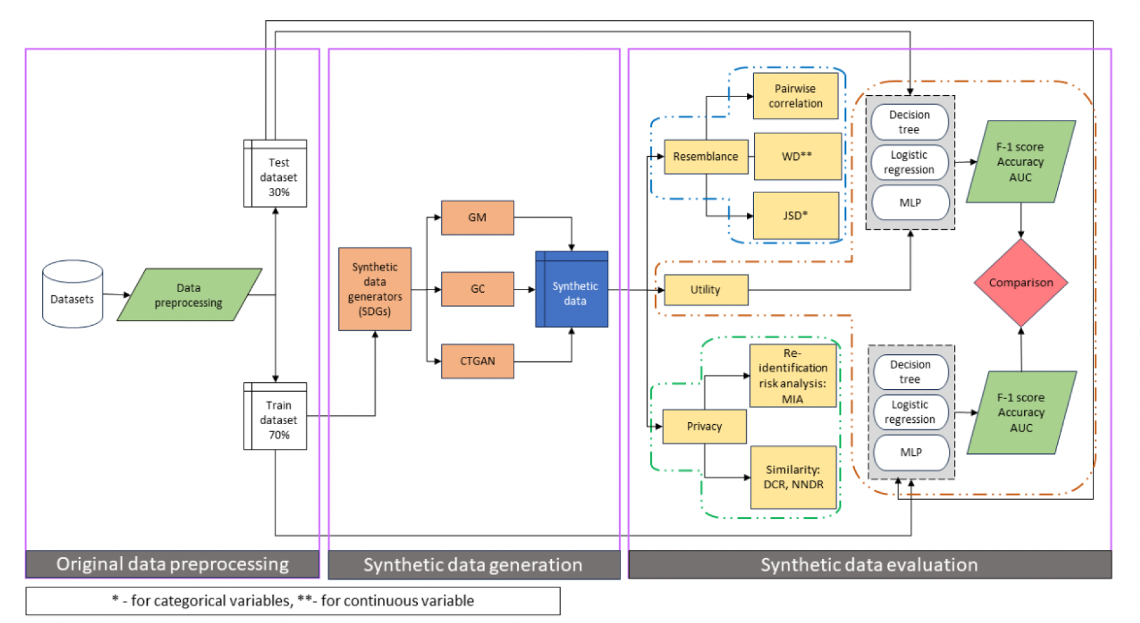
Methodology

Slide 9
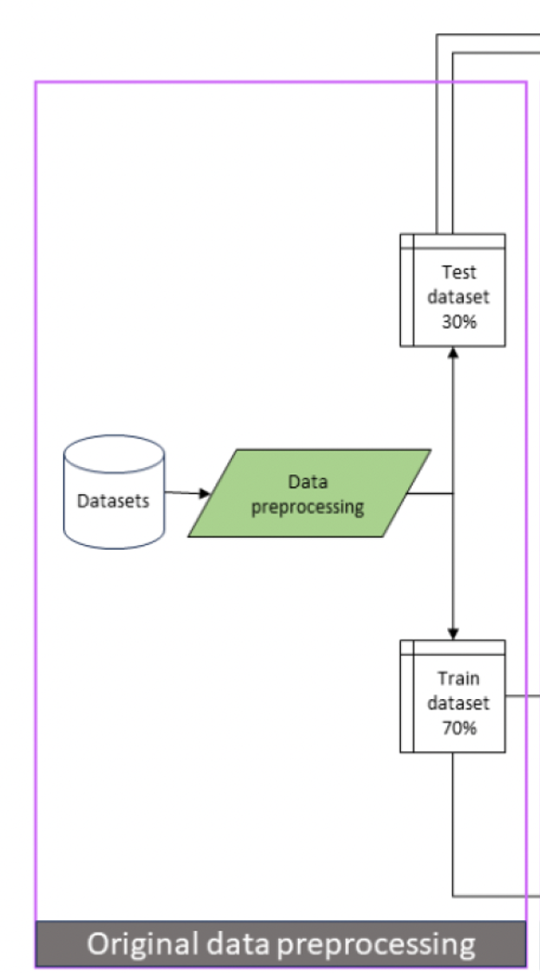
Methodology – original data processing

Slide 10
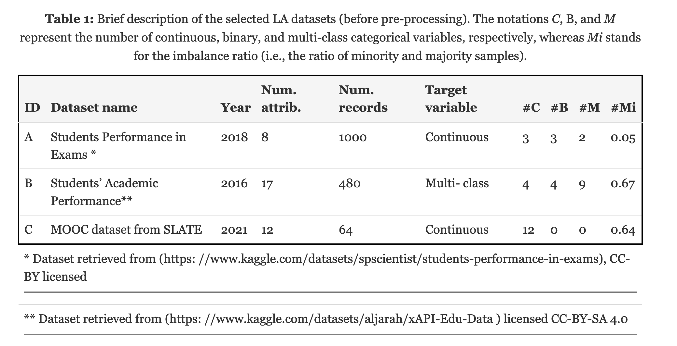
Dataset

Slide 11
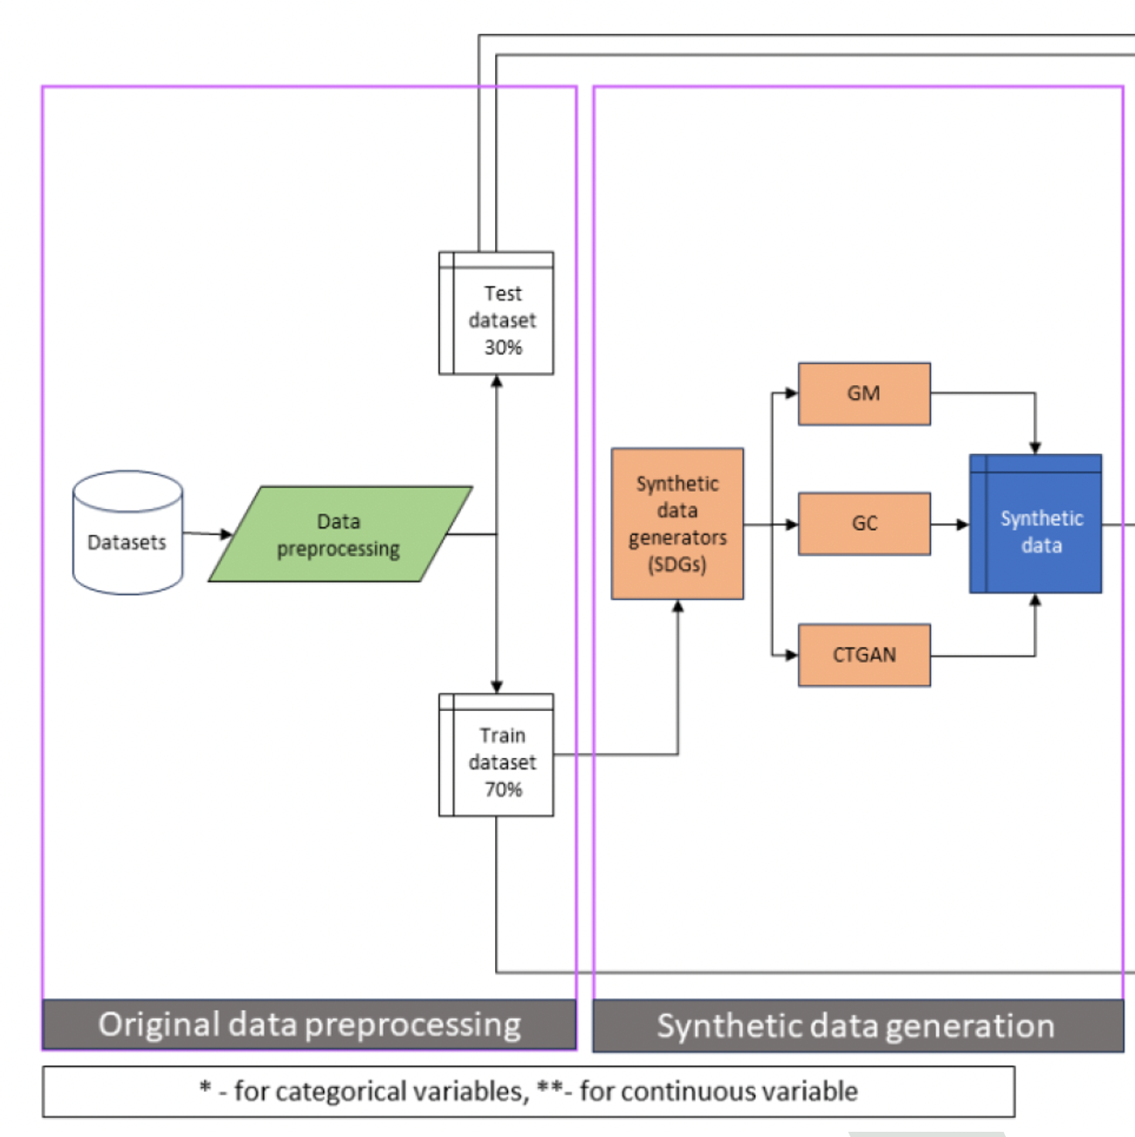
Methodology – synthetic data generation

Slide 12
Methodology – synthetic data evaluation

Slide 13
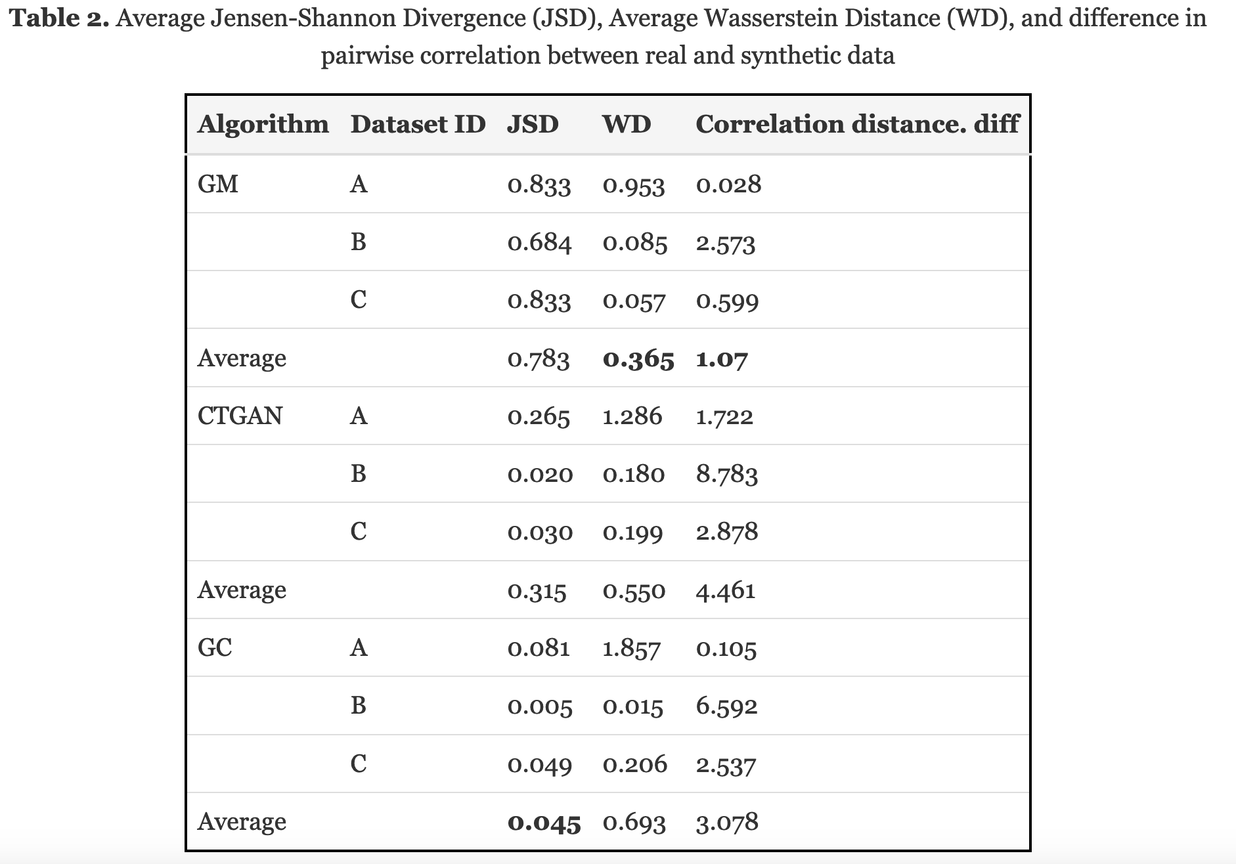
Methodology – synthetic data evaluation

Slide 14
Methodology – synthetic data evaluation

Slide 15
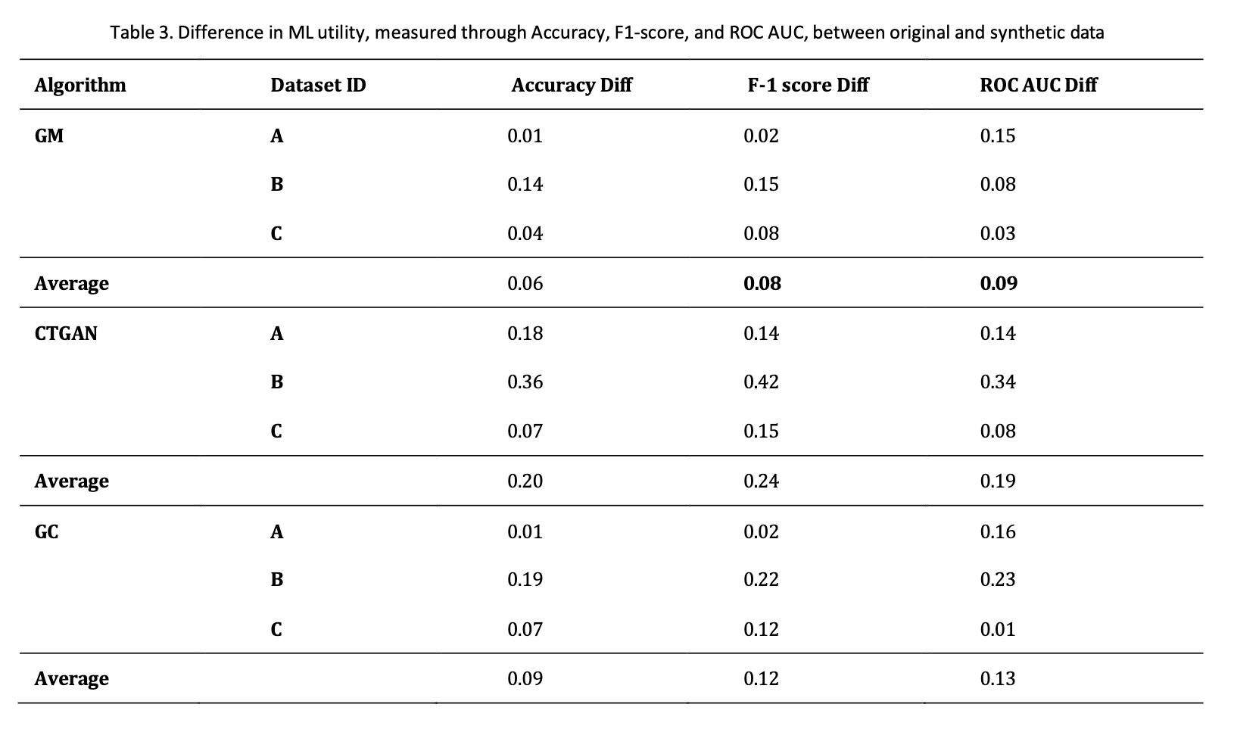
Findings - utility

Slide 16
Methodology – synthetic data evaluation

Slide 17
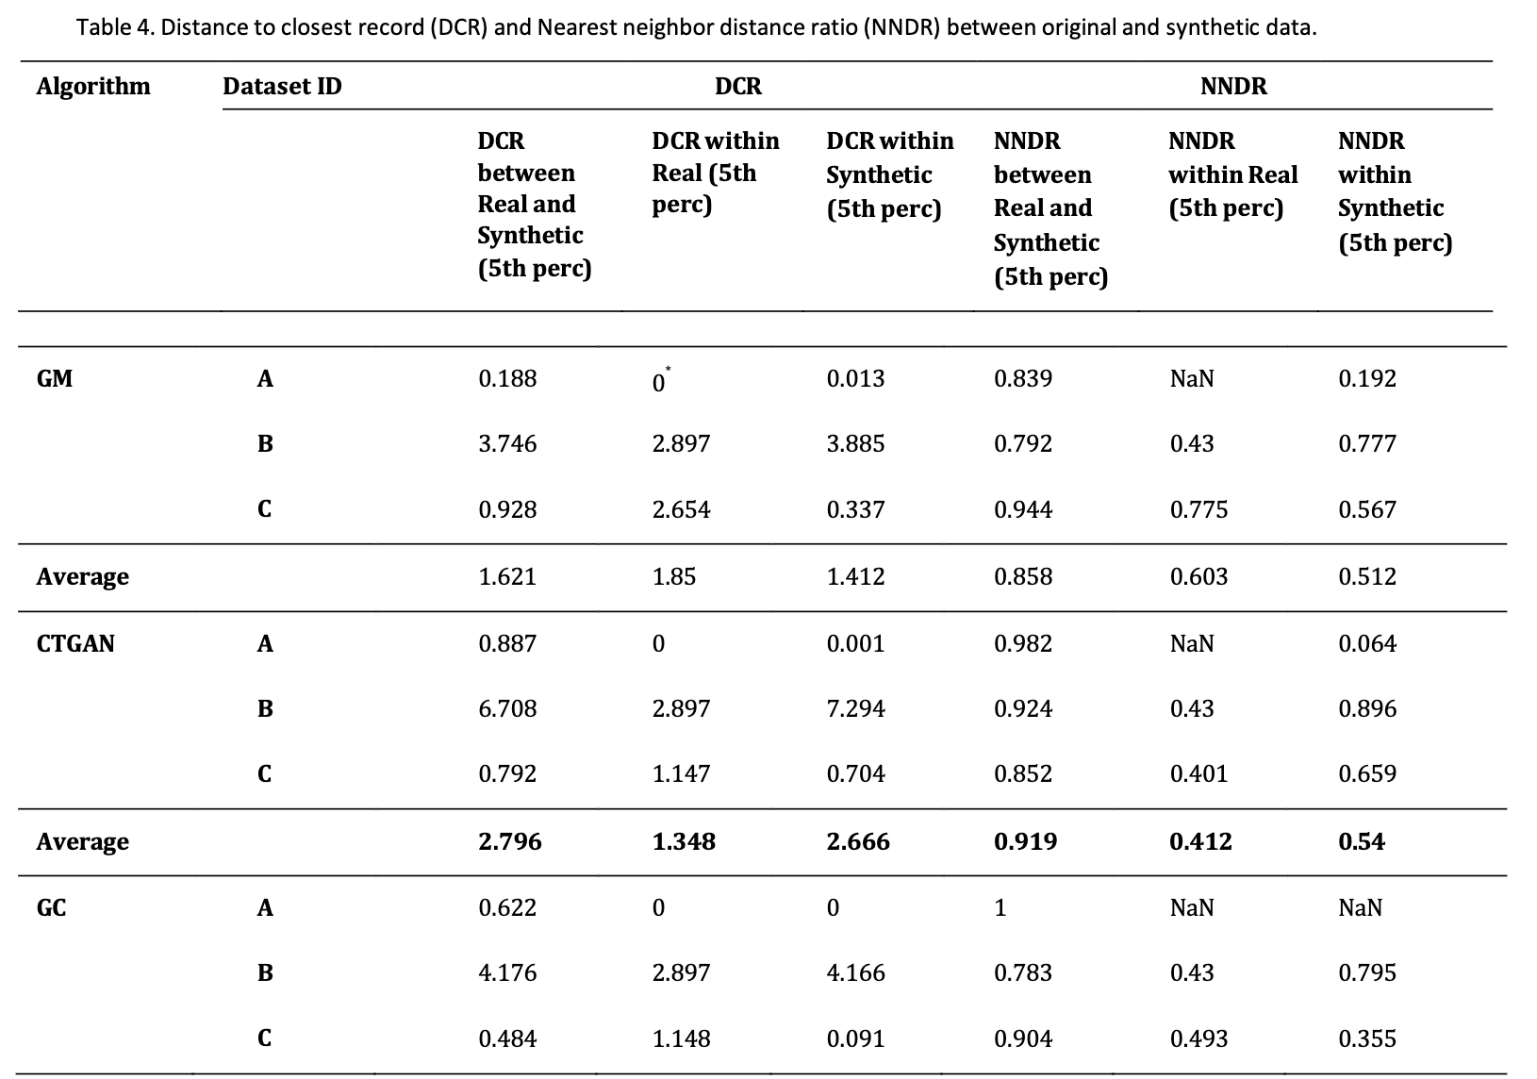
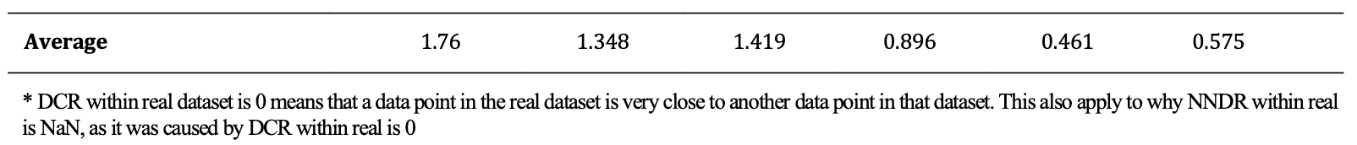
Findings – privacy

Slide 18
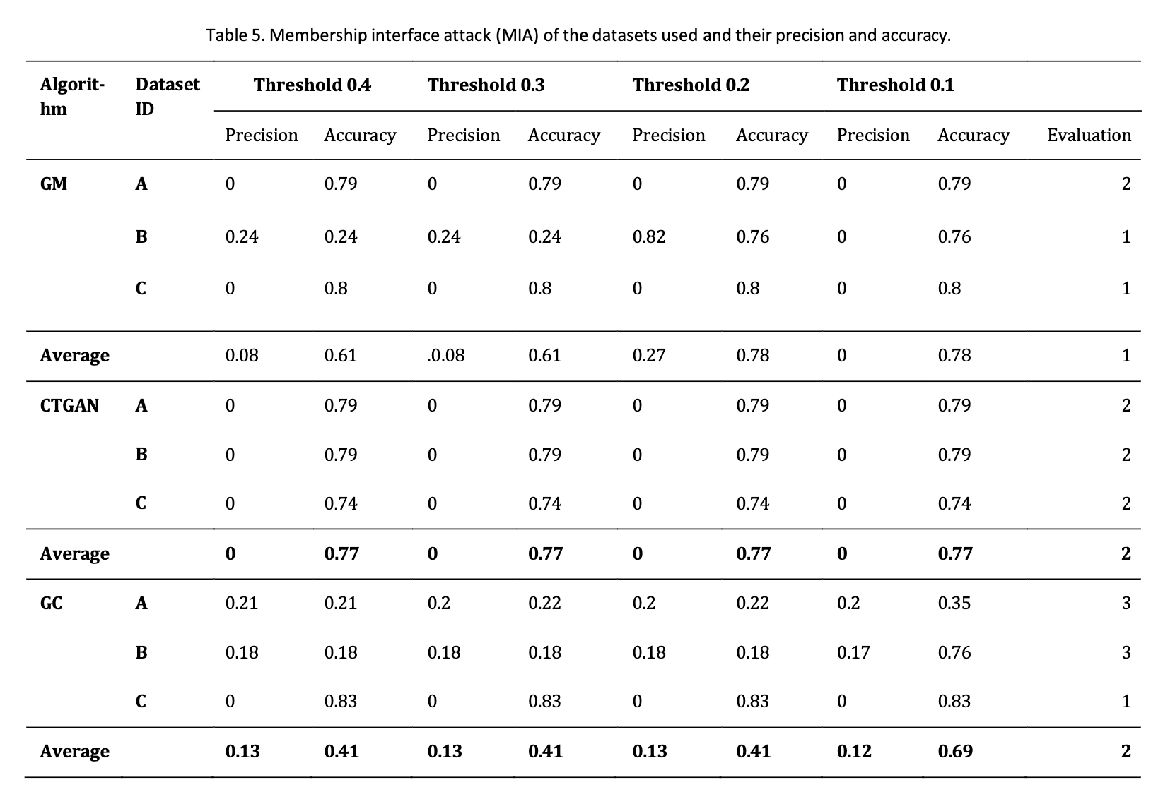
Findings – privacy

Slide 19
Customized data generation for different LA scenarios
relatively balanced demand for resemblance, utility, and privacy, where the performance of each dimension is equally weighted, such as the case of an independent LA researcher who wants to equally cover all dimensions;
high demand for utility and resemblance but little demand for privacy, such as in the context of an internal audit in an educational institution
low demand for utility but high demand for privacy, such as share dataset across country/region

Slide 20
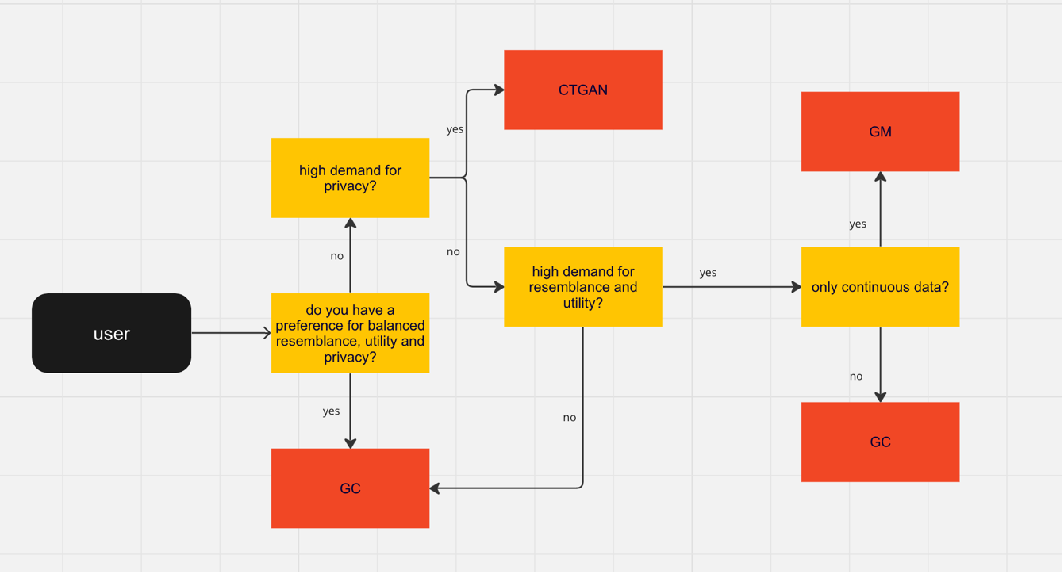
Customized data generation for different LA scenarios

Slide 21
Limitations
There are a variety of measures that can be used for each of the examined synthetic data dimensions. Due to the time restrictions, we only tested some of them.
data type and size of examined datasets is limited. E.g. time series data, dataset with 10K, 100K rows.

Slide 22
Conclusion
RQ1: a comprehensive evaluation of synthetic tabular data in terms of resemblance, ML utility, and privacy (RQ1)
RQ2: we show that it is possible to use synthetic data to enhance the privacy of a dataset while maintaining similar machine learning performance as the real dataset
RQ3: we hypothesized three different LA scenarios and gave recommendations for synthetic data generation based on the scenarios’ needs

Slide 23
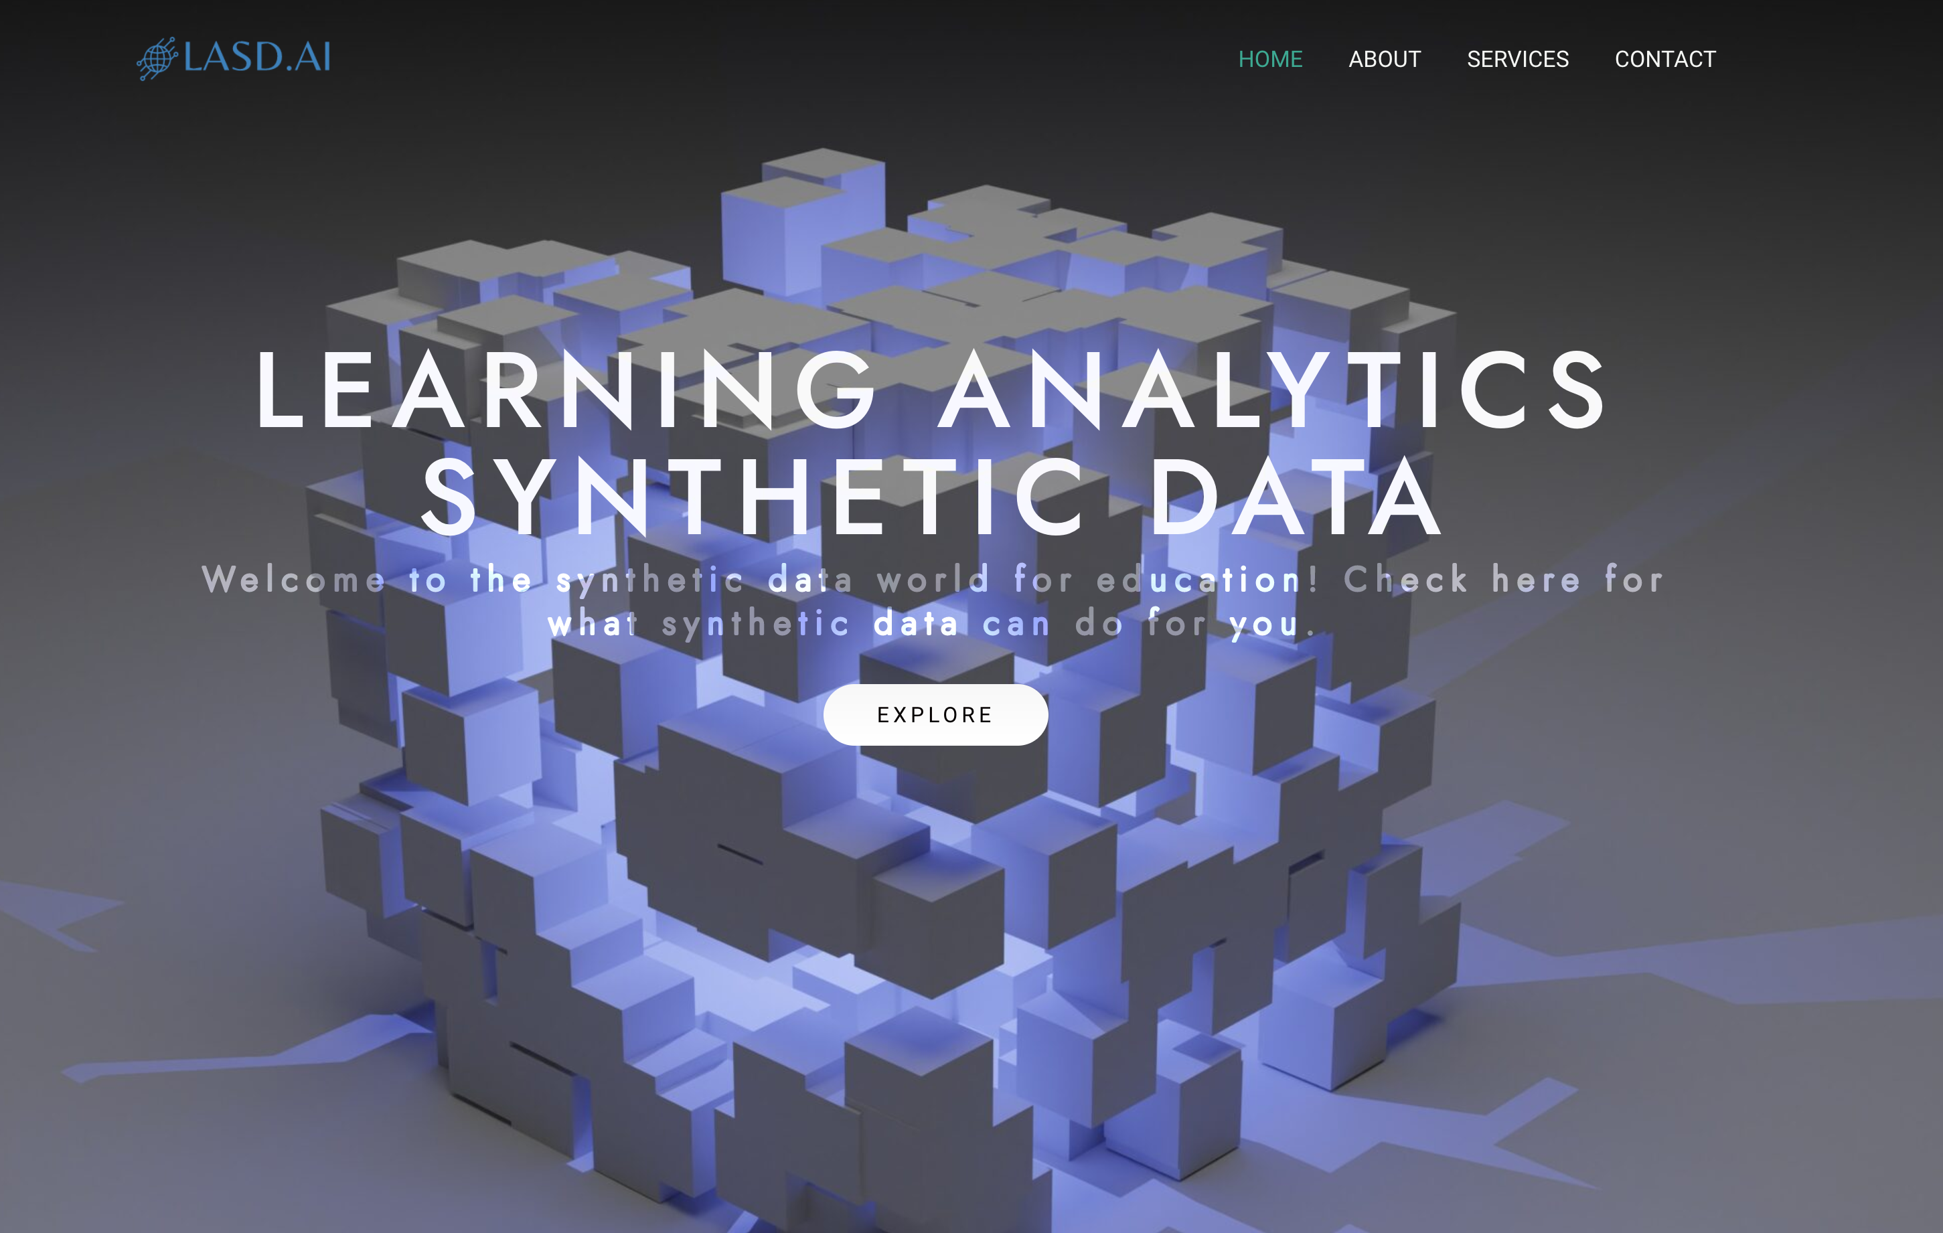
Future direction
Explore the use of synthetic data in the LA domain for multivariate data types (e.g., time-series data),
Explore how to prevent the misuse of synthetic data before malicious use of synthetic data occurs.
Build a user-friendly synthetic data generation platform specifically for learning analytics domain (www.lasd.ai)

Slide 24
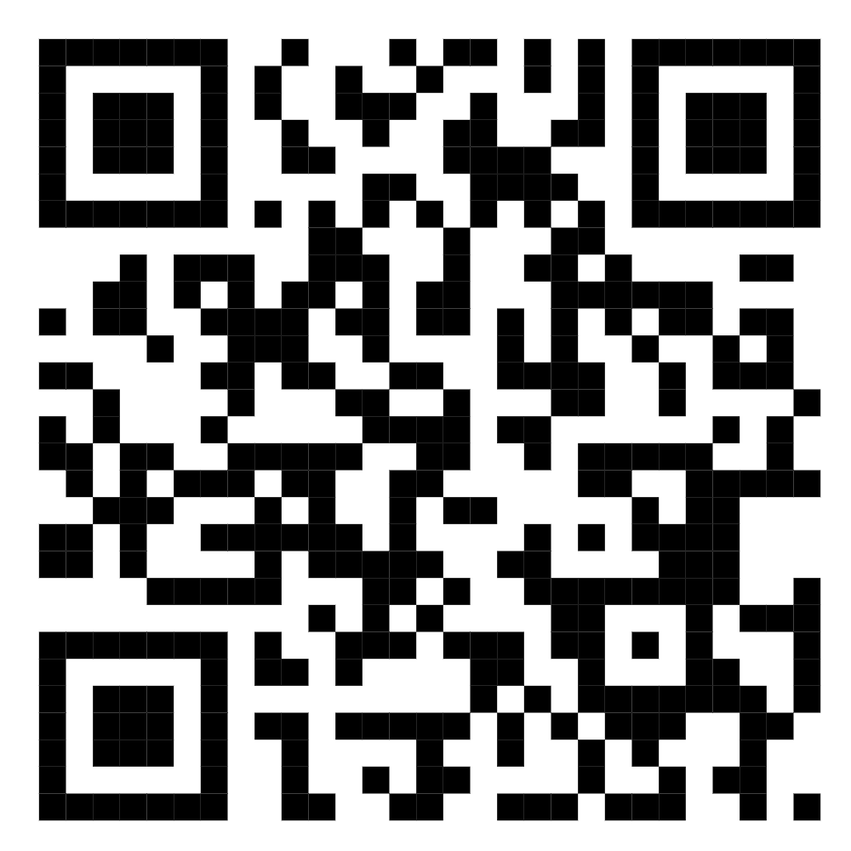
Thank you
Link to the paper
If you want to contact me: qinyi.liu@uib.no

